Slide 1
First-Order Logic
Chapter 8

Slide 2
Outline
Why FOL?
Syntax and semantics of FOL
Using FOL
Wumpus world in FOL
Knowledge engineering in FOL

Slide 3
Propositional logic
Propositional logic is declarative
  (unlike most data structures and databases)
Propositional logic is compositional:
  meaning of B_{1,1} ∧ P_{1,2} is derived from meaning of B_{1,1} and of P_{1,2}
Meaning in propositional logic is context-independent
  (unlike natural language, where meaning depends on context)
Propositional logic has very limited expressive power
  (unlike natural language)
  E.g., cannot say "pits cause breezes in adjacent squares“
    except by writing one sentence for each square
Propositional logic allows partial/disjunctive/negated information

Slide 4
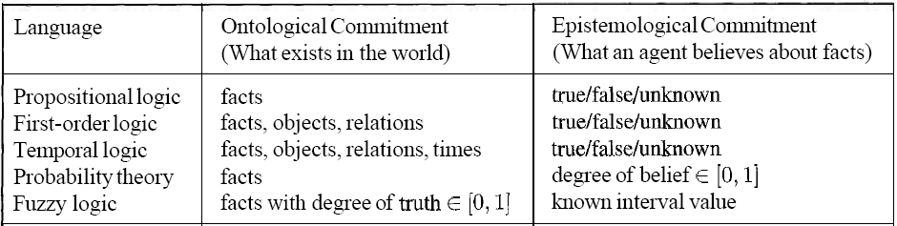
The Others

Slide 5
First-order logic
Propositional logic assumes the world contains facts
First-order logic (like natural language) assumes the world contains
  Objects: people, houses, numbers, colors, baseball games, wars, …
  Functions: father of, best friend, one more than, plus, …
  Relations: red, round, prime, brother of, bigger than, part of, comes between, …

Slide 6
Syntax of FOL: Basic elements
Constants: KingJohn, 2, SJTU,...
Predicates: Brother, >,...
Functions: Sqrt, LeftLegOf,...
Variables: x, y, a, b,...
Connectives: ¬, ⇒, ∧, ∨, ⇔
Equality: =
Quantifiers: ∀, ∃

Slide 7
Atomic sentences
Atomic sentence = predicate (term₁,...,term_{n}) or term₁ = term₂
Term = function (term₁,...,term_{n}) or constant or variable
E.g., Brother(KingJohn,RichardTheLionheart)
> (Length(LeftLegOf(Richard)), Length(LeftLegOf(KingJohn)))

Slide 8
Complex sentences
Complex sentences are made from atomic sentences using connectives
¬S, S₁ ∧ S₂, S₁ ∨ S₂, S₁ ⇒ S₂, S₁ ⇔ S₂,
E.g. Sibling(KingJohn,Richard) ⇒
Sibling(Richard,KingJohn)
>(1,2) ∨ ≤ (1,2)
>(1,2) ∧ ¬ >(1,2)

Slide 9
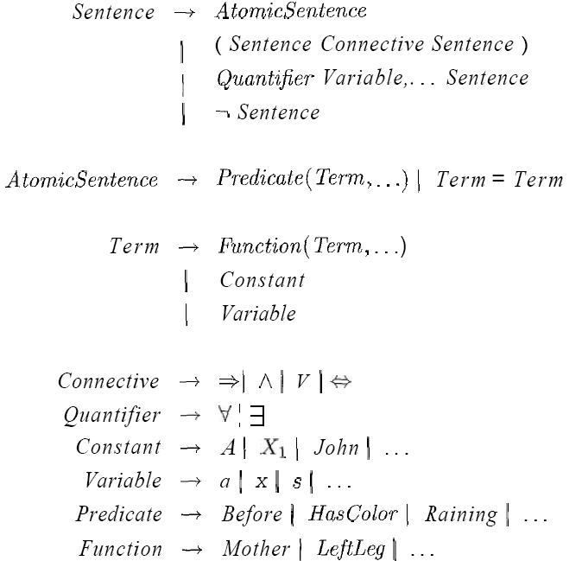
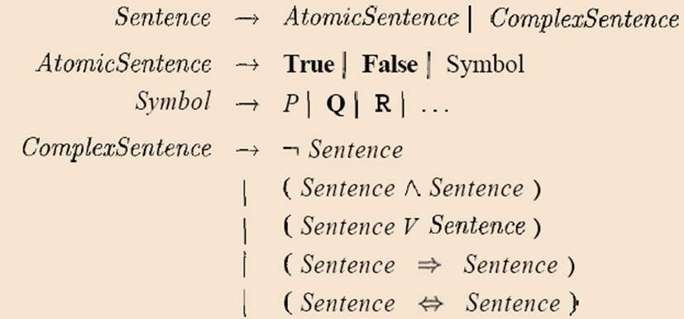
Syntax of FOL
Syntax of Propositional Logic

Slide 10
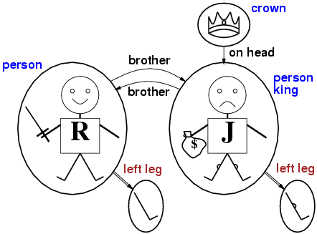
Models for FOL: Example

Slide 11
Universal quantification
∀<variables> <sentence>
Everyone at SJTU is smart:
∀x At(x,SJTU) ⇒ Smart(x)
∀x P is true in a model m iff P is true with x being each possible object in the model
Roughly speaking, equivalent to the conjunction of instantiations of P
    At(KingJohn,SJTU) ⇒ Smart(KingJohn) ∧
    At(Richard,SJTU) ⇒ Smart(Richard) ∧
    At(SJTU,SJTU) ⇒ Smart(SJTU) ∧ …
Question: Is it possible to represent the sentence in the following way
  ∀x At(x,SJTU) ∧ Smart(x)

Slide 12
A common mistake to avoid
Typically, ⇒ is the main connective with ∀
Common mistake: using ∧ as the main connective with ∀:
  ∀x At(x,SJTU) ∧ Smart(x) ⇔
  (At(Zhang,SJTU) ∧ Smart(Zhang)) ∧
  (At(Li,SJTU) ∧ Smart(Li)) ∧
  (At(Wang,SJTU) ∧ Smart(Wang)) ∧ ….
  means “Everyone is at SJTU and everyone is smart”
  Too strong!

Slide 13
Existential quantification
∃<variables> <sentence>
Someone at SJTU is smart:
∃x At(x,SJTU) ∧ Smart(x)
∃x P is true in a model m iff P is true with x being some possible object in the model
Roughly speaking, equivalent to the disjunction of instantiations of P
  At(KingJohn,SJTU) ∧ Smart(KingJohn) ∨
  At(Richard,SJTU) ∧ Smart(Richard) ∨
  At(SJTU,SJTU) ∧ Smart(SJTU) ∨……
  ??  x At(x,SJTU)  Smart(x)

Slide 14
Another common mistake
Typically, ∧ is the main connective with ∃
Common mistake: using ⇒ as the main connective with ∃:
  At(Zhang, SJTU) ⇒ Smart(Zhang) ∨
  At(Li, SJTU) ⇒ Smart(Li) ∨
  At(Wang, SJTU) ⇒ Smart(Wang) ∨…
The sentence is true is true if there is anyone who is not at SJTU!
Too weak!
x At(x,SJTU)  Smart(x)

Slide 15
Properties of quantifiers
∀x ∀y is the same as ∀y ∀x
∃x ∃y is the same as ∃y ∃x
∃x ∀y is not the same as ∀y ∃x
∃x ∀y Loves(x,y)
  “There is a person who loves everyone in the world”
∀y ∃x Loves(x,y)
  “Everyone in the world is loved by at least one person”
Quantifier duality: Each can be expressed using the other
∀x Likes(x,IceCream) ¬∃x ¬Likes(x,IceCream)
∃x Likes(x,Broccoli) ¬∀x ¬Likes(x,Broccoli)

Slide 16
Equality
term₁ = term₂ is true under a given interpretation if and only if term₁ and term₂ refer to the same object
E.g., definition of Sibling in terms of Parent:
  ∀x,y Sibling(x,y) ⇔ [¬(x = y) ∧ ∃m,f ¬ (m = f) ∧ Parent(m,x) ∧ Parent(f,x) ∧ Parent(m,y) ∧ Parent(f,y)]

Slide 17
Using FOL
The kinship domain:
One's mother is one's female parent
∀m,c Mother(c) = m ⇔ (Female(m) ∧ Parent(m,c))
“Sibling” is symmetric
  ∀x,y Sibling(x,y) ⇔ Sibling(y,x)
Brothers are siblings
x,y Brother(x,y)  Sibling(x,y)

Slide 18
Using FOL
The set domain:
∀s Set(s) ⇔ (s = {} ) ∨ (∃x,s₂ Set(s₂) ∧ s = {x|s₂})
¬∃x,s {x|s} = {}
∀x,s x ∈ s ⇔ s = {x|s}
∀x,s x ∈ s ⇔ [ ∃y,s₂} (s = {y|s₂} ∧ (x = y ∨ x ∈ s₂))]
∀s₁,s₂ s₁ ⊆ s₂ ⇔ (∀x x ∈ s₁ ⇒ x ∈ s₂)
∀s₁,s₂ (s₁ = s₂) ⇔ (s₁ ⊆ s₂ ∧ s₂ ⊆ s₁)
∀x,s₁,s₂ x ∈ (s₁ ∩ s₂) ⇔ (x ∈ s₁ ∧ x ∈ s₂)
∀x,s₁,s₂ x ∈ (s₁ ∪ s₂) ⇔ (x ∈ s₁ ∨ x ∈ s₂)

Slide 19
Interacting with FOL KBs
Suppose a wumpus-world agent is using an FOL KB and perceives a smell and a breeze (but no glitter) at t=5:
  Tell(KB,Percept([Smell,Breeze,None],5))
  Ask(KB,∃a BestAction(a,5))
i.e., does the KB entail some best action at t=5?
Answer: Yes, {a/Shoot} ← substitution (binding list)
Given a sentence S and a substitution σ,
Sσ denotes the result of plugging σ into S; e.g.,
  S = Smarter(x,y)
  σ = {x/Hillary,y/Bill}
  Sσ = Smarter(Hillary,Bill)
Ask(KB,S) returns some/all σ such that KB╞ σ

Slide 20
Knowledge base for the wumpus world
Perception
  ∀t,s,b Percept([s,b,Glitter],t) ⇒ Glitter(t)
Reflex
  ∀t Glitter(t) ⇒ BestAction(Grab,t)

Slide 21
Deducing hidden properties
∀x,y,a,b Adjacent([x,y],[a,b]) ⇔
[a,b] ∈ {[x+1,y], [x-1,y],[x,y+1],[x,y-1]}
Properties of squares:
∀s,t At(Agent,s,t) ∧ Breeze(t) ⇒ Breezy(s)
Squares are breezy near a pit:
  Diagnostic rule---infer cause from effect
    ∀s Breezy(s) ⇒ ∃ r Adjacent(r,s) ∧ Pit(r)
  Causal rule---infer effect from cause
    ∀r Pit(r) ⇒ [∀s Adjacent(r,s) ⇒ Breezy(s) ]

Slide 22
Knowledge engineering in FOL
Identify the task
Assemble the relevant knowledge
Decide on a vocabulary of predicates, functions, and constants
Encode general knowledge about the domain
Encode a description of the specific problem instance
Pose queries to the inference procedure and get answers
Debug the knowledge base

Slide 23
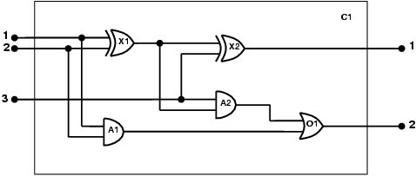
The electronic circuits domain
One-bit full adder

Slide 24
The electronic circuits domain
Identify the task
  Does the circuit actually add properly? (circuit verification)
Assemble the relevant knowledge
  Composed of wires and gates; Types of gates (AND, OR, XOR, NOT)
  Irrelevant: size, shape, color, cost of gates
Decide on a vocabulary
  Alternatives:
    Type(X₁) = XOR
    XOR(X₁)
    Type(X1, XOR)

Slide 25
The electronic circuits domain
Encode general knowledge of the domain
  ∀t₁,t₂ Connected(t₁, t₂) ⇒ Signal(t₁) = Signal(t₂)
  ∀t Signal(t) = 1 ∨ Signal(t) = 0
  1 ≠ 0
  t1,t2 Connected(t1, t2)  Connected(t2, t1)
  g Type(g) = OR  Signal(Out(1,g)) = 1  n Signal(In(n,g)) = 1
  g Type(g) = AND  Signal(Out(1,g)) = 0  n Signal(In(n,g)) = 0
  g Type(g) = XOR  Signal(Out(1,g)) = 1  Signal(In(1,g)) ≠ Signal(In(2,g))
  g Type(g) = NOT  Signal(Out(1,g)) ≠ Signal(In(1,g))

Slide 26
The electronic circuits domain
5. Encode the specific problem instance
  Type(X₁) = XOR Type(X₂) = XOR
  Type(A₁) = AND Type(A₂) = AND
  Type(O₁) = OR
  Connected(Out(1,X₁),In(1,X₂)) Connected(In(1,C₁),In(1,X₁))
  Connected(Out(1,X₁),In(2,A₂)) Connected(In(1,C₁),In(1,A₁))
  Connected(Out(1,A₂),In(1,O₁)) Connected(In(2,C₁),In(2,X₁))
  Connected(Out(1,A₁),In(2,O₁)) Connected(In(2,C₁),In(2,A₁))
  Connected(Out(1,X₂),Out(1,C₁)) Connected(In(3,C₁),In(2,X₂))
  Connected(Out(1,O₁),Out(2,C₁)) Connected(In(3,C₁),In(1,A₂))

Slide 27
The electronic circuits domain
Pose queries to the inference procedure
  What are the possible sets of values of all the terminals for the adder circuit?
Debug the knowledge base
  May have omitted assertions like 1 ≠ 0
  i1,i2,i3,o1,o2 Signal(In(1,C_1)) = i1  Signal(In(2,C1)) = i2  Signal(In(3,C1)) = i3  Signal(Out(1,C1)) = o1  Signal(Out(2,C1)) = o2

Slide 28
Simple Example
Sam, Clyde and Oscar are elephants. We know the following facts about them:
  Sam is pink.
  Clyde is gray and likes Oscar.
  Oscar is either pink or gray(but not both) and likes Sam
Prove a gray elephant likes a pink elephant.

Slide 29

Given the following facts：
Pink(A);
Gray(B);
Gray(C ) ∨ Pink(C );
¬ Gray(C ) ∨¬ Pink(C );
Likes(B,C);
Likes(C,A);
To prove (∃ x,y) [ Gray(x) ∧Pink(y) ∧ Likes(x,y)]

Slide 30
Summary
First-order logic:
  objects and relations are semantic primitives
  syntax: constants, functions, predicates, equality, quantifiers
Increased expressive power: sufficient to define wumpus world

